Slide 1

VARIABLES AND COMPONENTS
CHAPTER 19

Slide 2
Topics
Variables in C#
  Declaring and defining variables
Important C# Variable Types
Naming Conventions
Important Unity Variable Types
Unity GameObject Components

Slide 3
Variables in C#
Quick recap:
  A variable is a named container for data
  Variables in C# are typed, so they can only hold one type of data (e.g., an integer, a float, a string)
  Variables need to be declared to be used
    int x;
  Assigning a value to a variable is called defining the variable
    x = 5;
  A literal is a value that is entered into your code and can be assigned to a variable
    The 5 above is an integer literal
    string literals are surrounded by double quotes: "Hello World!"
    float literals are followed by an f: 3.14f

Slide 4
Important C# Variable Types
Core C# variable types start with a lowercase character
  bool
  int
  float
  char
  string
  class

Slide 5
Important C# Variable Types
bool – A 1-bit True or False Value
  Short for Boolean
  Named after George Boole (an English mathematician)
  bools in C# actually use more than 1-bit of space
    The smallest addressable memory chunk on a 32-bit system is 32 bits.
    The smallest on a 64-bit system is 64 bits.
  Literal examples: true false
  bool verified = true;

Slide 6
Important C# Variable Types
int – A 32-bit Integer
  Stores a single integer number
    Integers are numbers with no fractional or decimal element
  int math is very fast and accurate
  Can store numbers between –2,147,483,648 and 2,147,483,647
  31 bits used for number and 1 bit used for sign
  Literal examples: 1 34567 -48198
  int nonFractionalNumber = 12345;

Slide 7
Important C# Variable Types
float – A 32-bit Decimal Number
  Stores a floating-point number with a decimal element
    A floating-point number is stored in something like scientific notation
    Scientific notation is numbers in the format a*10^{b}: 300 is 3*10²
  Floating-point numbers are stored in the format a*2^{b}
    23 bits are used for the significand (the a part)
    8 bits are used for the exponent (the ^{b} part)
    1 bit determines whether the number is positive or negative
  Floats are inaccurate for large numbers and for numbers between -1 and 1
    There is no accurate float representation for 1 / 3
  Literal examples: 3.14f 123f 123.456f
  float notPreciselyOneThird = 1.0f / 3.0f;

Slide 8
Important C# Variable Types
char – A 16-bit Character
  Single character represented by 16 bits of information
  Uses Unicode values for the characters
    Unicode represents 110,000 different characters from over 100 different character sets and languages
  Floats are inaccurate for large numbers and for numbers between -1 and 1
    There is no accurate float representation for 1 / 3
  Uppercase and lowercase letters are different values!
  char literals are surrounded by single quotes
  Literal examples: 'A' 'a' '\t'
  char theLetterA = 'A';

Slide 9
Important C# Variable Types
string – A Series of 16-bit Characters
  Stores from no characters ("") to an entire novel
    Max length is 2 billion chars; 12,000 times the length of Hamlet
  string literals are surrounded by double quotes
  Literal examples: "Hello" "" "\tTab"
  string theFirstLineOfHamlet = "Who's there?";
  You can access individual characters via bracket access
    char theCharW = theFirstLineOfHamlet[0];
    char questionMark = theFirstLineOfHamlet[11];
  The length of a string is accessed via .Length
    int len = theFirstLineOfHamlet.Length;
      Sets len to 12

Slide 10
Important C# Variable Types
class – A Collection of Functions and Data
  A class creates a new variable type
  Covered extensively in Chapter 25, "Classes"
  Already used in the HelloWorld project
    public class HelloWorld : MonoBehaviour {
    void Start() {
    print("Hello World!");
    }
    }
  Everything between the braces { } is part of the class

Slide 11
C# Naming Conventions
Use camelCase for almost everything
Variable names start with lowercase:
  thisVariable anotherVariable bob
Function names start with uppercase:
  ThatFunction() Start() Update()
Class names start with uppercase:
  SomeClass GameObject HeroShip
Private variables start with underscore:
  _privateVariable _hiddenVariable
Static variables use SNAKE_CASE:
  STATIC_VAR NUM_INSTANCES

Slide 12
Important Unity Variable Types
Because they are classes, important Unity variable types all start with an uppercase character
  Vector3
  Color
  Quaternion
  Mathf
  Screen
  SystemInfo
  GameObject

Slide 13
Important Unity Variable Types
Vector3 – A collection of 3 floats
  Used for position of objects in 3D
    Vector3 vec = new Vector3( 3, 4, 0 );
  Instance variables and functions
    vec.x – The x component of the vector
    vec.y – The y component of the vector
    vec.z – The z component of the vector
    vec.magnitude – The length of the vector
    vec.Normalize() – New Vector3 in the same direction at unit length
  Static class variables and functions
    Vector3.zero – Shorthand for new Vector3( 0, 0, 0 );
    Vector3.Dot( vA, vB ); – Dot product of vA and vB

Slide 14
Important Unity Variable Types
Color – A color with transparency information
  4 floats for red, green, blue, and alpha (all between 0 and 1)
    Color col = new Color( 0.5f, 0.5f, 0, 1f );
    Color col = new Color( 1f, 0f, 0f ); // Alpha is optional
  In the Unity color picker, the RGBA values are in the range 0–255. These are then mapped to 0–1f.
  Instance variables and functions
    col.r – The red component of the vector
    col.g – The green component of the vector
    col.b – The blue component of the vector
    col.a – The alpha component of the vector

Slide 15
Important Unity Variable Types
Color – A color with transparency information
  Static class variables and functions
    // Primary Colors: Red, Green, and Blue
    Color.red = new Color(1, 0, 0, 1); // Solid red
    Color.green = new Color(0, 1, 0, 1); // Solid green
    Color.blue = new Color(0, 0, 1, 1); // Solid blue
    // Secondary Colors: Cyan, Magenta, and Yellow
    Color.cyan = new Color(0, 1, 1, 1); // Cyan, a bright greenish blue
    Color.magenta = new Color(1, 0, 1, 1); // Magenta, a pinkish purple
    Color.yellow = new Color(1, 0.92f, 0.016f, 1); // A nice-looking yellow
    // As you can imagine, a standard yellow would be new Color(1,1,0,1), but
    // in Unity's opinion, this color looks better.
    // Black, White, and Clear
    Color.black = new Color(0, 0, 0, 1); // Solid black
    Color.white = new Color(1, 1, 1, 1); // Solid white
    Color.gray = new Color(0.5f, 0.5f, 0.5f, 1) // Gray
    Color.grey = new Color(0.5f, 0.5f, 0.5f, 1) // British spelling of gray
    Color.clear = new Color(0, 0, 0, 0); // Completely transparent

Slide 16
Important Unity Variable Types
Quaternion – Rotation information
  Based on three imaginary numbers and a scalar
  So, everyone uses Euler angles (e.g., x, y, z) to input rotation
    Quaternion up45Deg = Quaternion.Euler( -45, 0, 0 );
  In Euler (pronounced "oiler") angles, x, y, & z are rotations about those respective axes
  Quaternions are much better for interpolation and calculations than Euler angles
    They also avoid Gimbal Lock (where two Euler axes align)
  Instance variables and functions
    up45Deg.eulerAngles – A Vector3 of the Euler rotations

Slide 17
Important Unity Variable Types
Mathf – A collection of static math functions
  Static class variables and functions
    Mathf.Sin(x); // Computes the sine of x
    Mathf.Cos(x); // .Tan(), .Asin(), .Acos(), & .Atan() also available
    Mathf.Atan2( y, x ); // Gives you the angle to rotate around the z-axis to
    // change something facing along the x-axis to face
    // instead toward the point x, y.
    print(Mathf.PI); // 3.141593; the ratio of circumference to diameter
    Mathf.Min( 2, 3, 1 );// 1, the smallest of the numbers (float or int)
    Mathf.Max( 2, 3, 1 );// 3, the largest of the numbers (float or int)
    Mathf.Round( 1.75f );// 2, rounds up or down to the nearest number
    Mathf.Ceil( 1.75f ); // 2, rounds up to the next highest integer number
    Mathf.Floor( 1.75f );// 1, rounds down to the next lowest integer number
    Mathf.Abs( -25 ); // 25, the absolute value of -25

Slide 18
Important Unity Variable Types
Screen – Information about the display
  Static class variables and functions
    Screen.width // The width of the screen in pixels
    Screen.height // The height of the screen in pixels
    Screen.showCursor = false; // Hide the cursor

Slide 19
Important Unity Variable Types
SystemInfo – Information about the device/computer
  Static class variables and functions
    SystemInfo.operatingSystem // The width of the screen in pixels
    // e.g., Mac OS X 10.9.3
    SystemInfo.systemMemorySize // Amount of RAM
    SystemInfo.supportsAccelerometer // Has accelerometer
    SystemInfo.supportsGyroscope // Has gyroscope

Slide 20
Important Unity Variable Types
GameObject – Base class for all objects in scenes
  Composed of components
    GameObject go = new GameObject("MyGO");
  Always has a Transform component
  Instance variables and functions
    go.name // The name of the GameObject ("MyGO")
    go.GetComponent<Transform>() // The Transform component
    go.transform // A shortcut to the Transform component
    go.SetActive(false) // Make this GameObject inactive
    go.name // The name of the GameObject ("MyGO")
  GetComponent<>() is a generic method that can be used to access any component attached to a GameObject

Slide 21
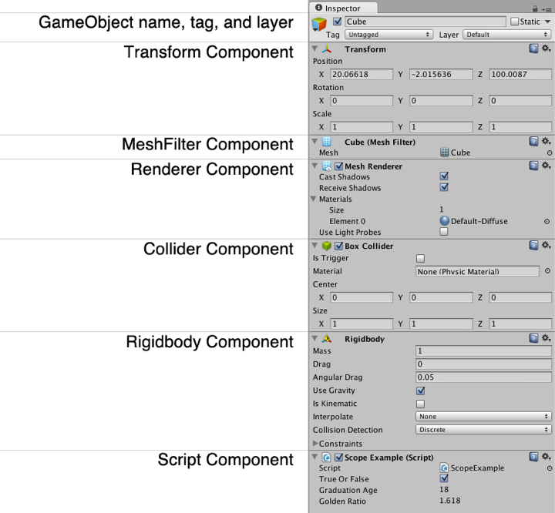
Unity GameObject Components
GameObjects are composed of Components

Slide 22
Unity GameObject Components
Transform component
  Controls position, rotation, and scale
    Transform tr = go.GetComponent<Transform>();
  Also controls hierarchy of objects in the scene
    tr.parent // The parent of this transform in the hierarchy
  Children can be iterated over with a foreach loop
    foreach (Transform tChild in tr) {…}
  Instance variables and functions
    tr.position // The position in world coordinates
    tr.localPosition // The position relative to its parent
    tr.rotation // The rotation in world coordinates
    tr.localScale // The scale (always in local coordinates)

Slide 23
Unity GameObject Components
MeshFilter component
  The model that you see
    MeshFilter mf = go.GetComponent<MeshFilter>();
  Attaches a 3D model to a GameObject
  Is actually a 3D shell of the object (3D objects in games are hollow inside
  This MeshFilter is rendered on screen by a MeshRenderer component

Slide 24
Unity GameObject Components
Renderer component
  Draws the GameObject on screen
    Renderer rend = go.GetComponent<Renderer>();
  Usually, this is a MeshRenderer
    Renderer is the superclass for MeshRenderer
    So, Renderer is almost always used in code
  Combines the MeshFilter with a Material (which contains various Textures and a Shader)

Slide 25
Unity GameObject Components
Collider component
  The physical presence of the GameObejct
    Collider coll = go.GetComponent<Collider>();
  There are four types of collider (in order of complexity)
    Sphere Collider – The fastest type. A ball or sphere.
    Capsule Collider – A pipe with spheres at each end. 2nd fastest.
    Box Collider – A rectangular solid. Useful for crates, cars, torsos, etc.
    Mesh Collider – Collider formed from a MeshFilter. Much slower!
      Only convex Mesh Collider can collide with other Mesh Colliders
      Much, much slower than the other three types
  Unity physics are performed by the NVIDIA PhysX engine
  Colliders will not move without a Rigidbody component

Slide 26
Unity GameObject Components
Rigidbody component
  The physical simulation of the GameObject
    Rigidbody rigid = go.GetComponent<Rigidbody>();
  Handles velocity, bounciness, friction, gravity, etc.
  Updates every FixedUpdate()
    This is exactly 50 times per second
  If Rigidbody isKinematic == true, the collider will move, but position will not change automatically due to velocity
    rigid.isKinematic = true; // rigid will not move on its own
  Colliders will not move without a Rigidbody component

Slide 27
Unity GameObject Components
(Script) components
  Any C# class that you write
    HelloWorld hw = go.GetComponent<HelloWorld>();
  Because C# scripts are handled as components, several can be attached to the same GameObject
    This enables more object-oriented programming
    You'll see several examples throughout the book
  Public fields in your scripts will appear as editable fields in the Unity Inspector
    However, Unity will often alter the names of these fields a bit
      The class name ScopeExample becomes Scope Example (Script).
      The variable trueOrFalse becomes True Or False.
      The variable graduationAge becomes Graduation Age.
      The variable goldenRatio becomes Golden Ratio.

Slide 28
Chapter 19 – Summary
Learned about declaring and defining C# variables
Learned several important C# variable types
  These all start with lowercase letters
Learned naming conventions used in this book
Important Unity Variable Types
  These all start with uppercase letters
Learned several Unity GameObject components
Next chapter will introduce you to Boolean operations and the conditionals used to control C# code

